Slide 1
Exploring business opportunities in setting up Food joint by exploring venues of Bengaluru, India.
Rajesh B Raut

Slide 2
Introduction/ Description of problem
IBM Data Science Capstone Project- Battle of Neighborhood
India being a food-loving country with each region having its own special cuisine, Indians have never been very big on eating out. But the scenario is changing now. The restaurant industry in India and in Bengaluru as well has been growing at a rapid pace over the past few years or so and the growth story is set to continue for the next foreseeable future.
This project aims to explore venue related to food joints in various regions of Bengaluru city using Foursquare API. This project would help all those interested in setting up food joint such as Restaurant, Pizza Place, café etc. in various region pf Banglore city. This would help to analyse which type of food joint and its number are already there in a particular region so as to decide the type of food joint to set up in that particular region.

Slide 3
Data
IBM Data Science Capstone Project- Battle of Neighborhood
Wikipedia.org
To get the Neighborhood data of Banglore city
Foursquare API
To find Venues and Venue categories in various regions of Banglore city

Slide 4
Methodology
IBM Data Science Capstone Project- Battle of Neighborhood
I have got the ‘Neighbourhood’ data from Wikipedia page (https://en.wikipedia.org/wiki/List_of_neighbourhoods_in_Bangalore). Finding the latitude and longitude of Banglore various and and Neighbourhoods are shown by generating the map of Banglore city using ‘folium’.
I have used the Four Square API through the Region and its Neighbourhoods. Regions and Venue category have also been obtained by making Foursqaure API call. Count of region wise venue category was also obtained

Slide 5
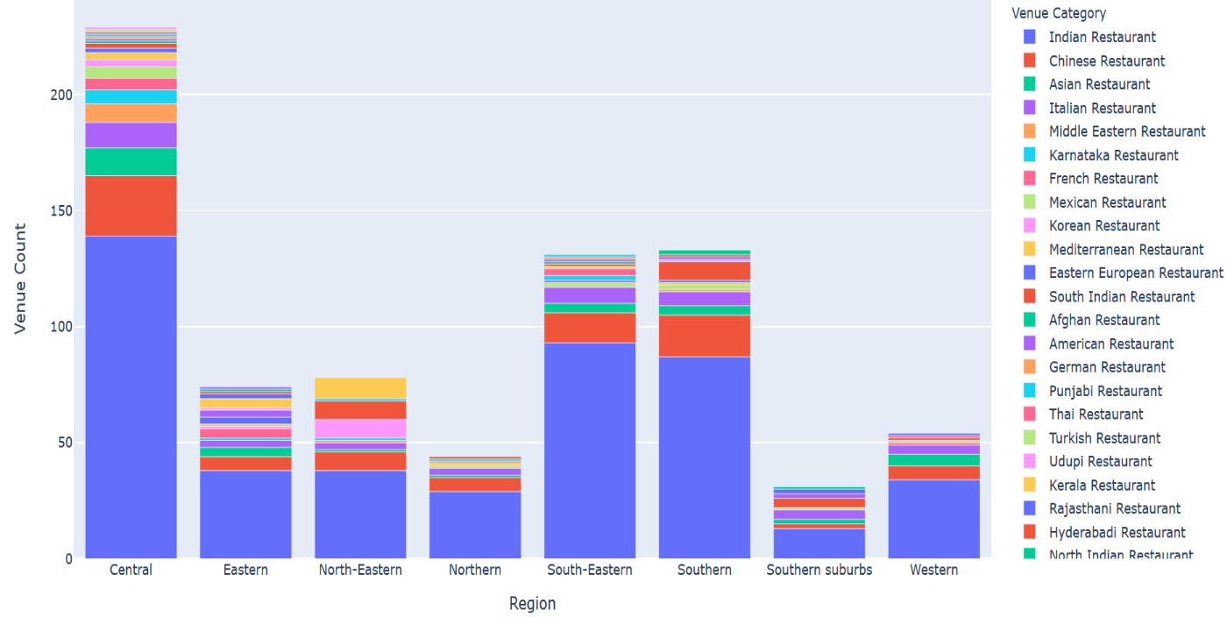
Results
IBM Data Science Capstone Project- Battle of Neighborhood
Region wise distribution of various food joints (Venue categories)

Slide 6
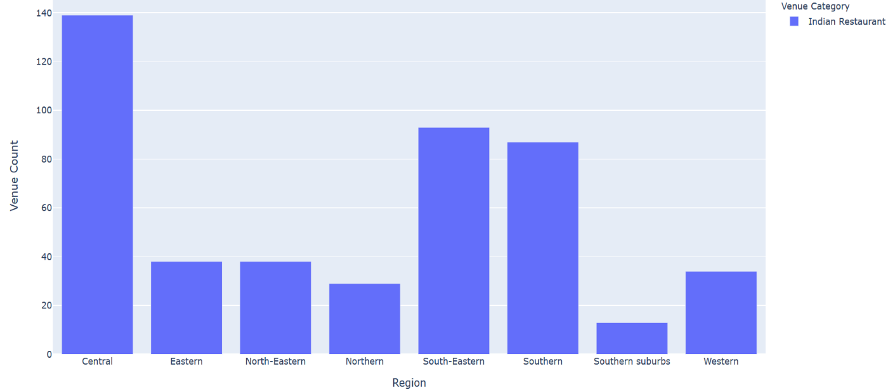
Results
IBM Data Science Capstone Project- Battle of Neighborhood
Region wise distribution of India Restaurants

Slide 7
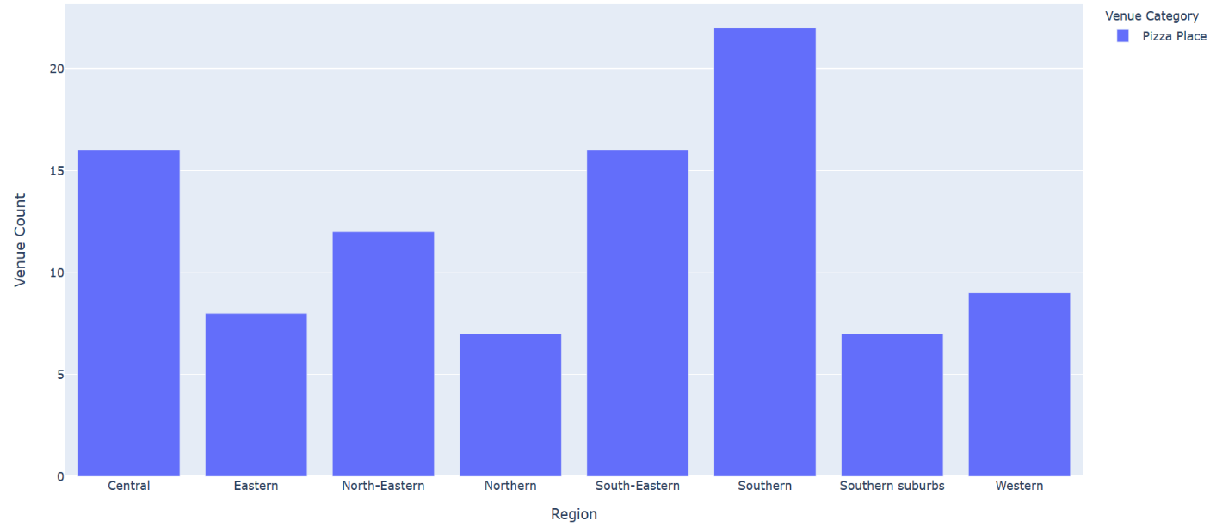
Results
IBM Data Science Capstone Project- Battle of Neighborhood
Region wise distribution of Pizza Places

Slide 8
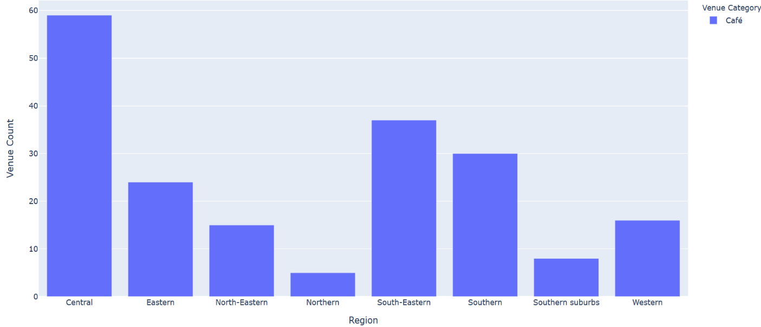
Results
IBM Data Science Capstone Project- Battle of Neighborhood
Region wise distribution of Café

Slide 9
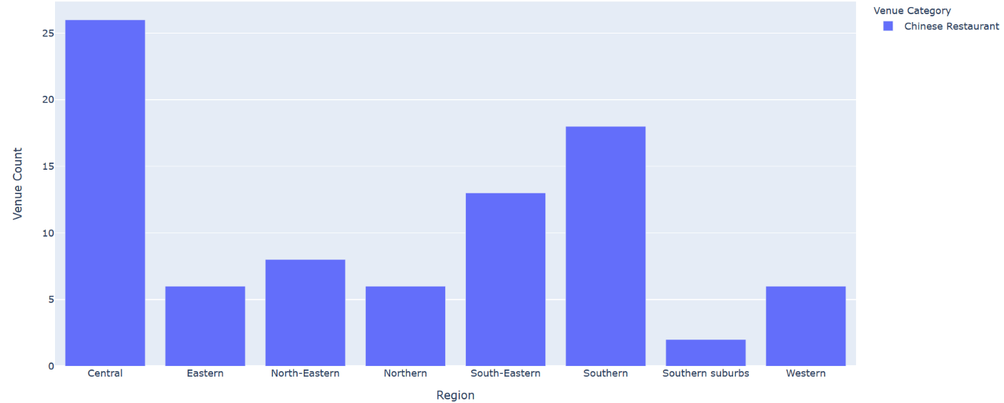
Results
IBM Data Science Capstone Project- Battle of Neighborhood
Region wise distribution of Chinese Restaurants

Slide 10
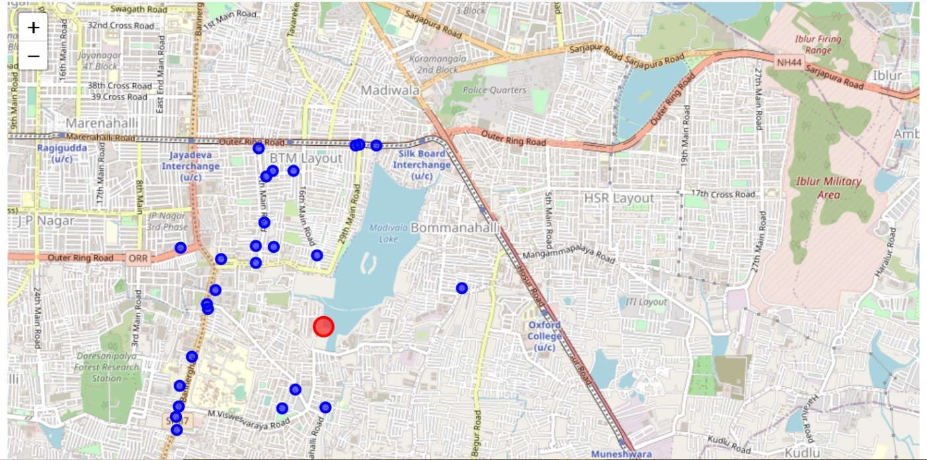
Results- Maps of Central region with location of Chinese Restaurants
IBM Data Science Capstone Project- Battle of Neighborhood
Region wise distribution of Chinese Restaurants

Slide 11
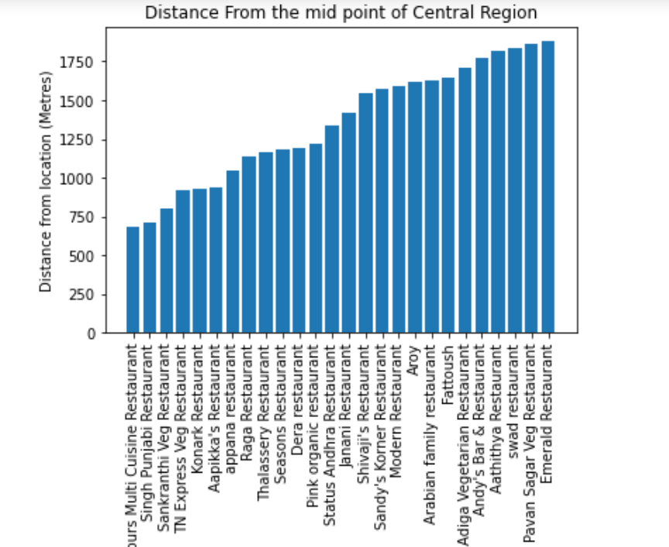
Results- Minimum distance
IBM Data Science Capstone Project- Battle of Neighborhood
Minimum distance
Minimum distance to the nearest Chinese Restaurant from core location is 685 metres

Slide 12
Discussion
IBM Data Science Capstone Project- Battle of Neighborhood
Discussion
The above result section showed the locations and number of food joints exists in various regions of Banglore city. We have seen that the distance of a particular type of food joint from the middle of the given region. From various results we have obtained as above we could get an idea which type of food joint can be set up in the given region. This would help the new entrepreneur to start a business venture in a particular region.

Slide 13
Conclusion
IBM Data Science Capstone Project- Battle of Neighborhood
Conclusion
As a business person, one would be able to set up a food joint at a suitable location. This analysis would definitely help them to set a successful venture which will bring revenue and prosperity.

Slide 14
Thanks!
Thank you Coursera and my fellow learners!

